Slide 1
Week-2
Part 1: Basics of MongoDB
Part 2: Getting Started with MongoDB
Introduction to MongoDB
MongoDB is a document-oriented NoSQL database. It is easy to access by indexing and supports various data types, including dates and numbers. MongoDB is the most popular NoSQL database today, empowering users to query, manipulate, and find interesting insights from their collected data. It can also be used for a variety of purposes because of the flexibility of storing structured or unstructured data. In this module, you will learn about the characteristics of MongoDB and expand your hands-on working knowledge of MongoDB performing various common tasks including create, read, update, and delete (CRUD) operations, limit and sort records, indexing, and aggregation. You will explore replication and sharding, which are very important concepts in MongoDB. The scale and availability we see with MongoDB is achieved using these two concepts.
Learning Objectives
Define MongoDB.
Identify the key benefits of using MongoDB.
List and describe the most common use cases for MongoDB.
Create collections on a MongoDB server and perform basic operations on them.
Use a mongo shell to connect to a MongoDB database and perform basic CRUD operations.
Explain why we need indexes and describe how MongoDB stores them.
Use indexes to perform efficient searches and sorts in MongoDB.
Explain what the Aggregation Framework is in MongoDB and describe where you can use it.
Build aggregation pipelines in MongoDB.
Describe what replication is.
Explain how sharding helps to scale a database.
Define MongoClient.
Use MongoClient to interact with MongoDB.
Build a Python program to run MongoDB operations.

Slide 2
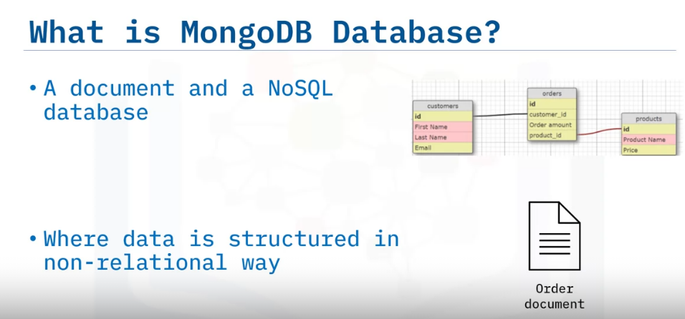
Overview of MongoDB
Explain what MongoDB is
List the different components of MongoDB
Describe why and where to use MongoDB
MongoDB is a document and a NoSQL database.
Instead of storing data in tables of rows or columns like SQL databases, each record in a MongoDB database is a document, And you store the data in a non-relational way.

Slide 3
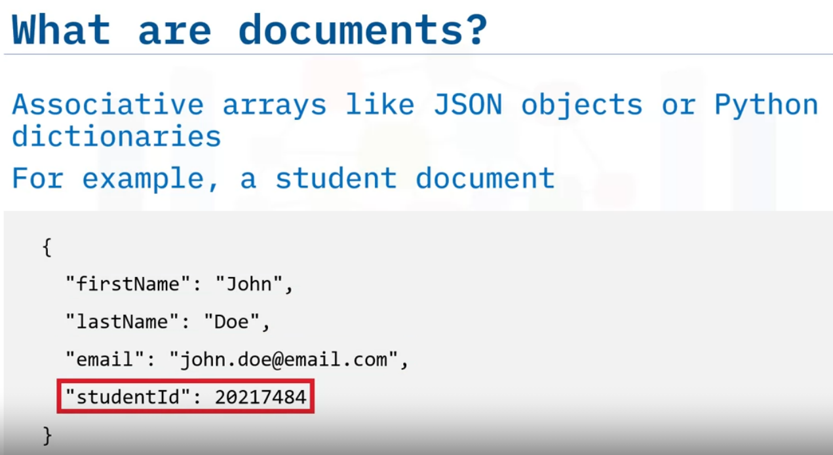
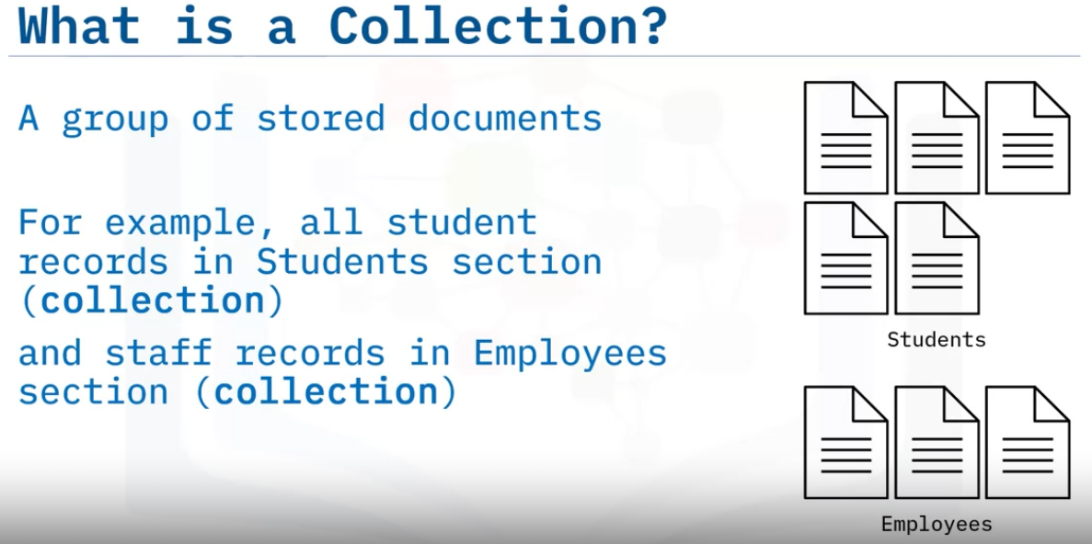
Documents are associative arrays like JSON objects or Python dictionaries.
For example, a student document representing a student’s first name, last name, email address, and ID.
MongoDB documents of similar type are grouped into a collection.
Our campus management system stores all student records or documents in the Students collection.
And similarly, all staff documents are stored in the Employees collection.

Slide 4
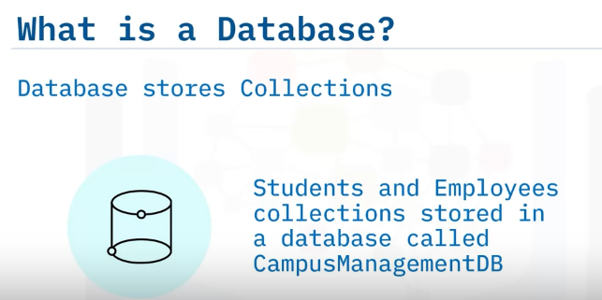
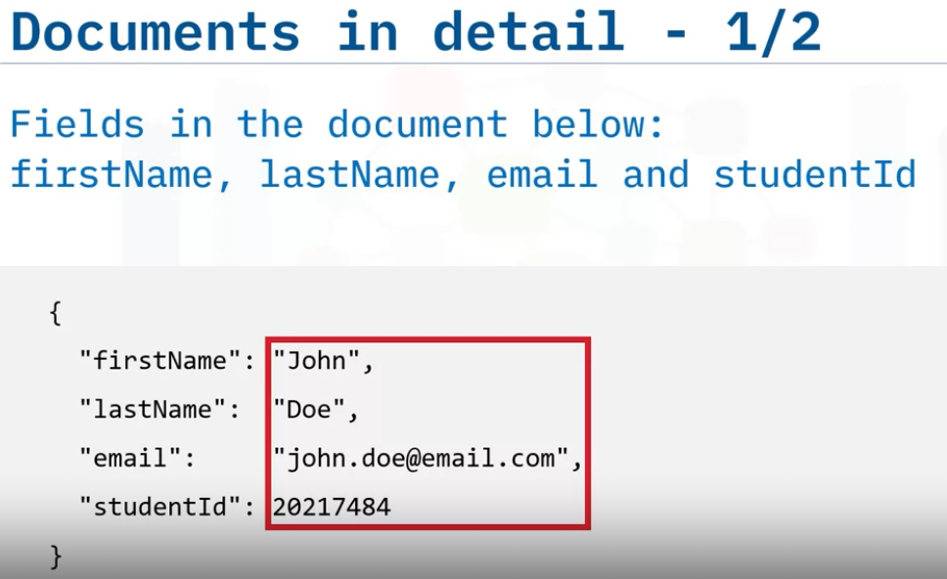
So, what is a database?
Following our previous example, The campus management system stores all different types of data related to it in a MongoDB database called Campus Management DB.
Let’s dissect our document.
In the document below, firstName, lastName, email, and studentId are fields or properties, with values representing a student named John Doe, And each field name is unique within that document.

Slide 5
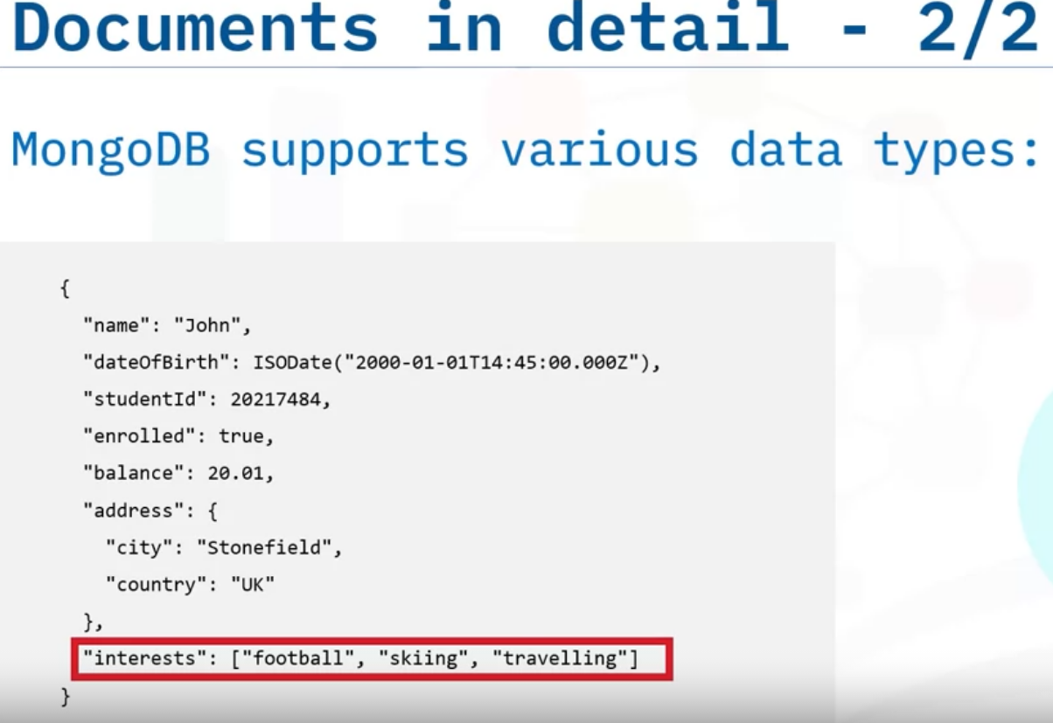
MongoDB supports variety of data types, so you have the full capability to use the correct data type to store your information in.
For example, Dates should be stored as ISODate or Unix style epoch dates, which will help you with queries like “Give me all students born between 15th of January to 15th of February.”
Numbers can be stored either as whole numbers or decimals.
Being a document database, MongoDB also allows you to store sub-documents to group secondary information together.
It also supports lists of values. Not just text, but even different kinds mixed together.

Slide 6
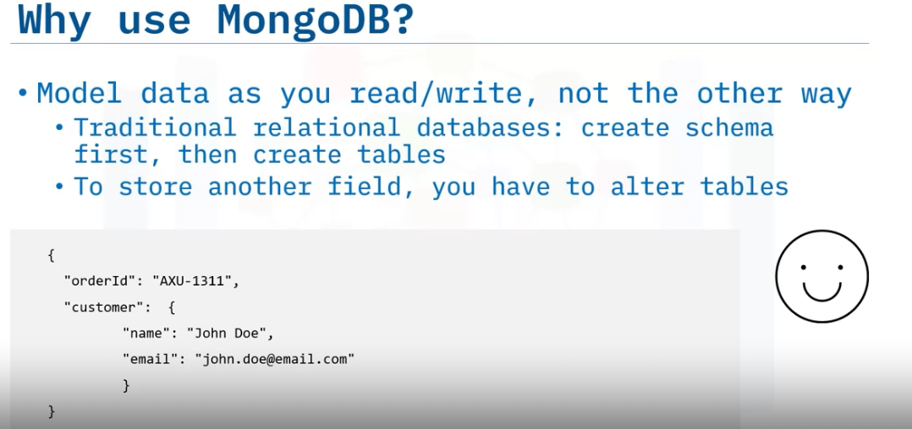
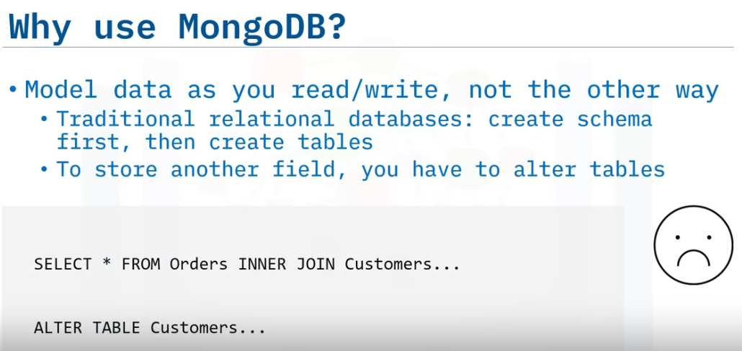
Working with MongoDB is easy because you can focus on the data you are writing and how you are going to read it.
Traditional relational databases required you to create the schema first, then create table structures that will hold your data.
So, if you decide to store an additional field, you will then have to alter your tables.
In MongoDB, you change as you go along.

Slide 7
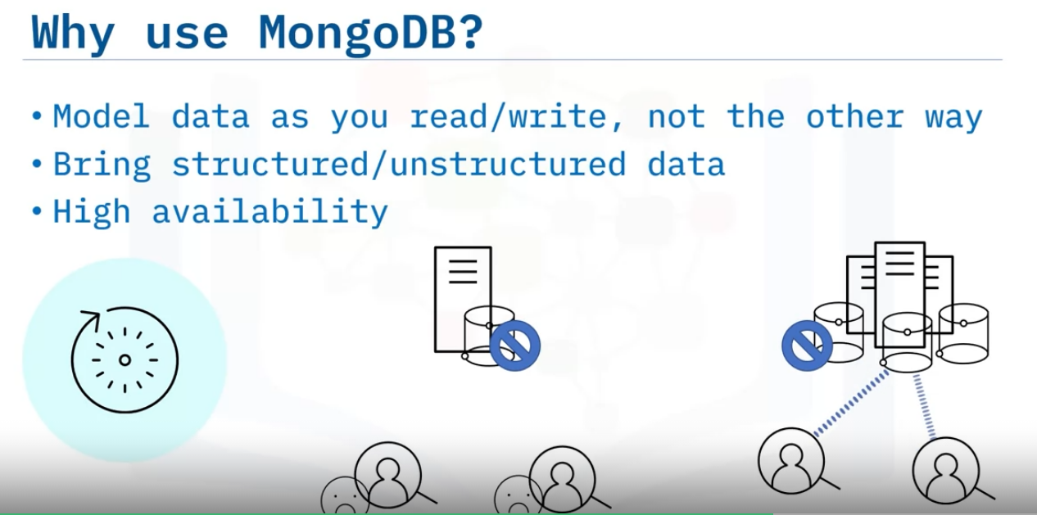
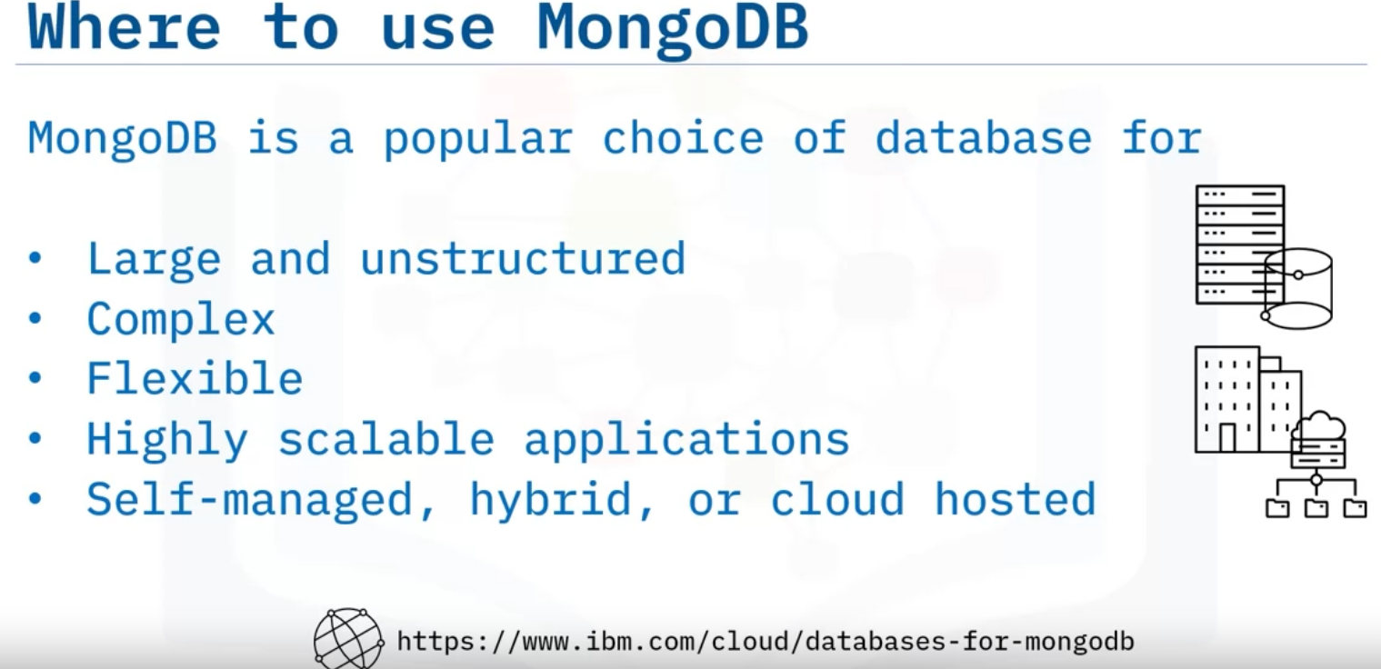
MongoDB also gives you the power to bring in any structured or unstructured data.
MongoDB also provides high availability by keeping multiple copies of your data.
you can design complex data structures easily in MongoDB without worrying about the complexity of how it is stored and how it should be linked.
For example, your Campus Management application is also launched in the USA, where they do not store postcodes, but have zip codes.
Scalability provided by MongoDB means as your data needs grow, you can easily scale vertically, by introducing bigger, faster, better hardware, or horizontally, by partitioning your data.
All of that can be done whether you are running a self-managed on-premises MongoDB, or the hybrid or cloud hosted and fully managed services such as IBM Cloud Databases for MongoDB or MongoDB Atlas on AWS, Azure, and Google Cloud.

Slide 8
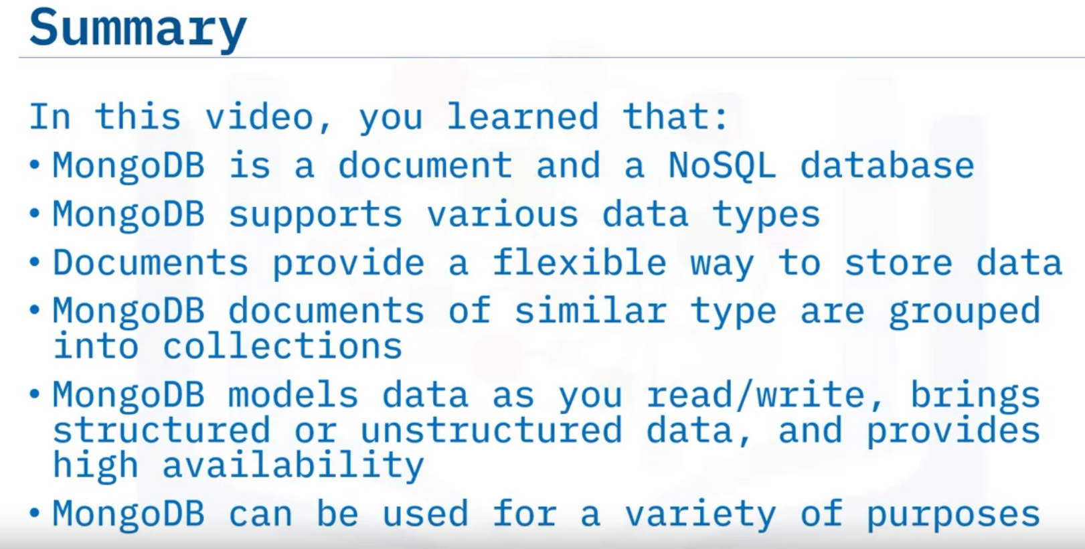

Slide 9
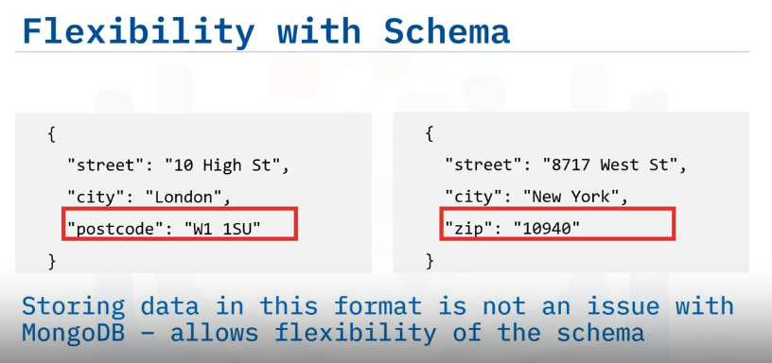
Advantages of MongoDB
Identify the key benefits of using MongoDB.
And explain why it suits your evolving data needs.
The first of the key benefits of using MongoDB is the flexibility of its schema.
Compare the two addresses shown here.
There is no zip code for UK addresses, and no postcode for American addresses.
In a relational world, where fields names must be present in each row, this would cause us to have either overarching fields, or a lot of fields with no values.
But storing in this format in MongoDB is not a problem, because it allows us this flexibility with the schema.
This also allows us to store unstructured data.
For example, combining data of different shapes from different sources for analysis or storage.
1. Flexibility with Schema

Slide 10
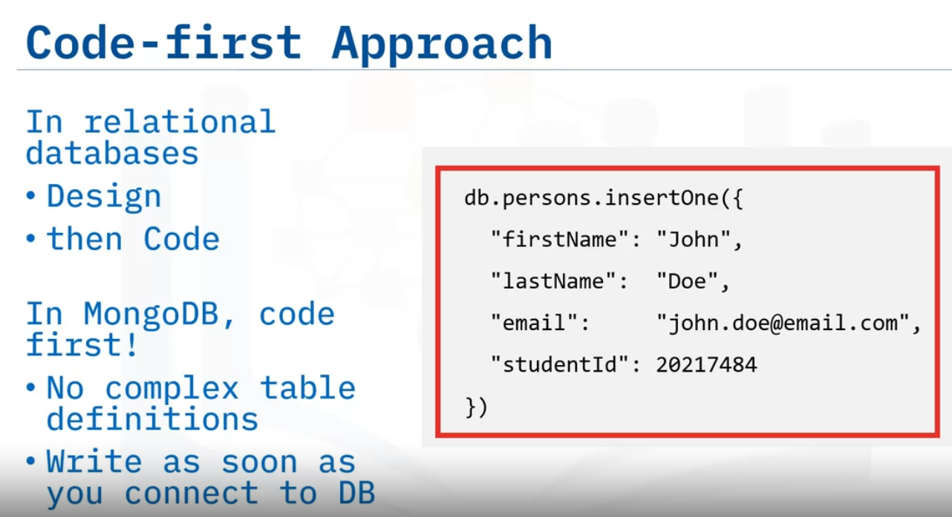
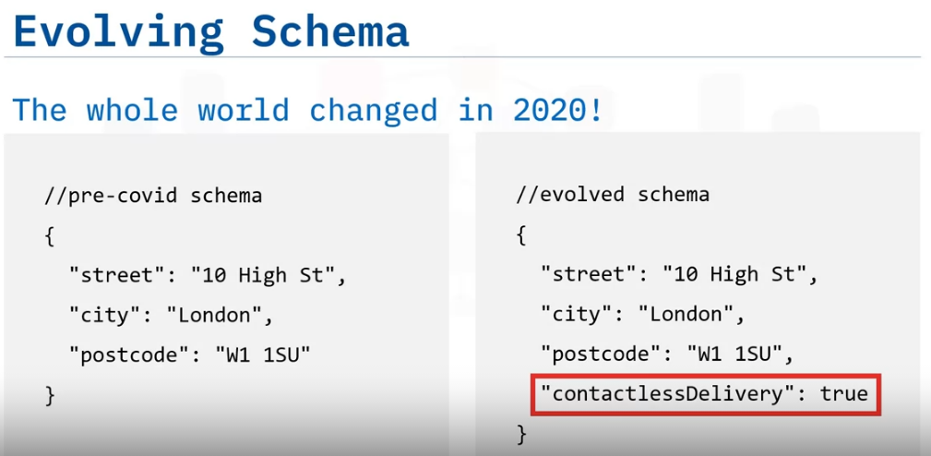
2.Code First Approach
The second key benefit of using MongoDB is its code-first approach.
Relational databases add complexity when you start, because first you need to create your table design, and only then are you allowed to work on your database.
Since MongoDB works on documents, it means you can access your data without having any complexity in between.
There are no complex table definitions. You can start writing your first data as soon as you connect to your MongoDB database.
This also eliminates the use of any third-party frameworks to give you read and write operations.
3.Evolving Schema
The third key benefit is an evolving schema.
Imagine you run a courier company, so you need to store delivery addresses.
With the massive changes in delivery procedures introduced in 2020, you need to quickly evolve your schema to store additional information about contactless delivery with minimal disruption.
With MongoDB, this is easily possible. All you need is to start storing this additional information in your delivery documents.

Slide 11
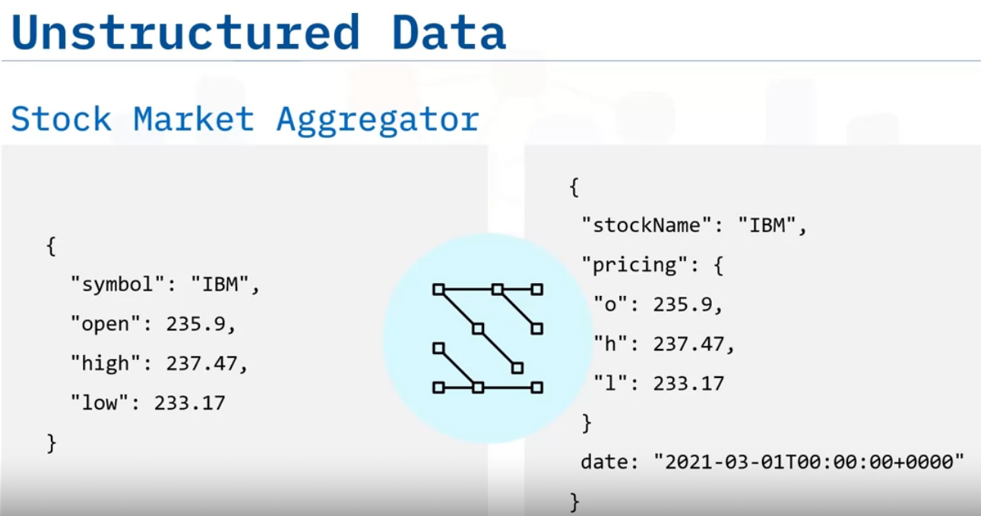
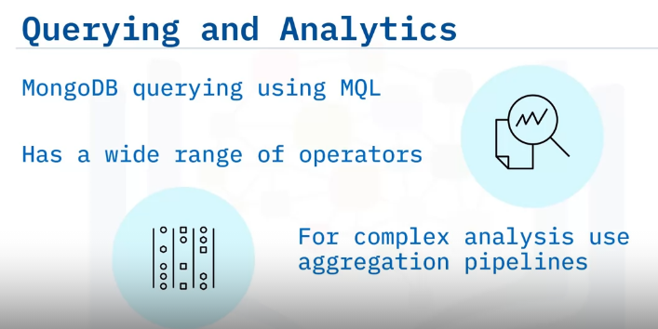
Let’s look at an example of a stock market aggregator.
This collects stock data from different sources.
Each piece of source data can be in a different shape, which means it is essentially unstructured data when it comes into MongoDB.
With the flexibility MongoDB provides, we can store all of this data together in one collection.
4.Querying and Analytics
The next key benefit is querying and analytics capabilities.
Mongo Query Language, or MQL, has a number of operators that you can use to build fairly complex queries to find your data.
If your queries are even more complex, you can use Aggregation pipelines within MongoDB.
For example: Group all student results by their year group, and find top scoring students by semester.

Slide 12
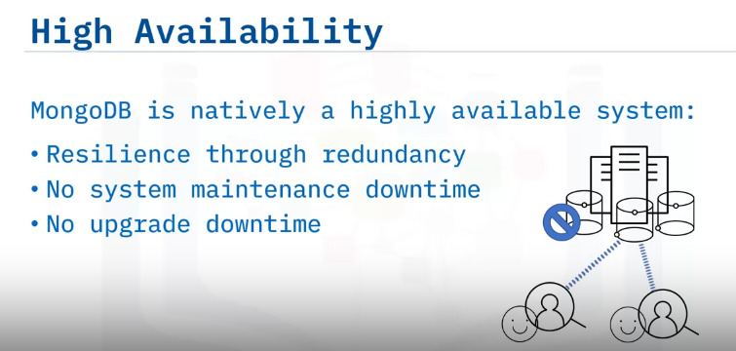
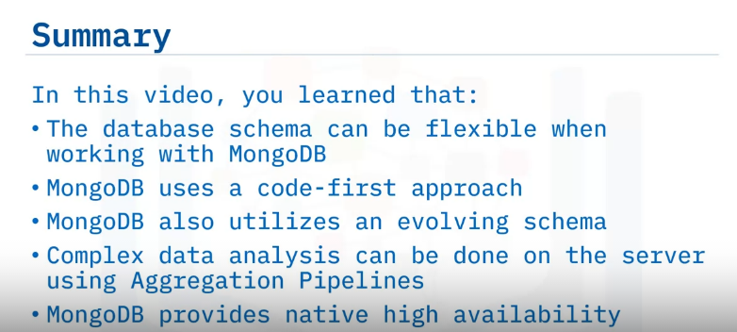
5.HA
The last key benefit we will discuss is high availability.
MongoDB natively supports being a highly available system by means of redundancy.
Typical MongoDB setups are three-node replica sets, where one of them is a primary member and the others are secondary members.
Replication keeps a copy of your data on other data bearing nodes in the cluster.
If one system fails, the other one takes over and you do not see any downtime.
This also works for system maintenance situations where you might take away a node for making updates to software, operating systems, file systems, security patches, or your MongoDB version.

Slide 13
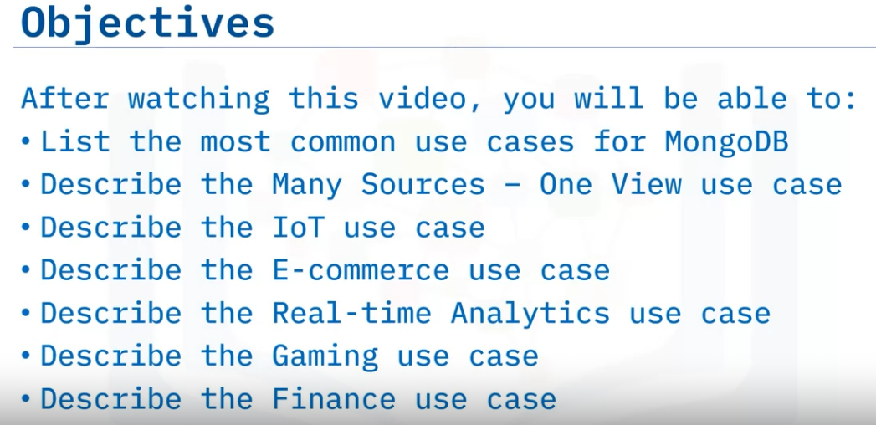
Use Cases for MongoDB

Slide 14
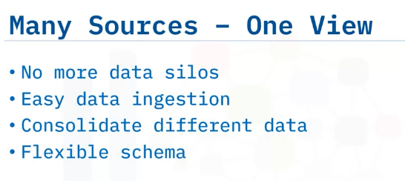
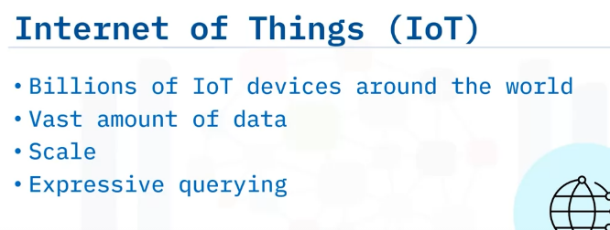
MongoDB allows you to bring data from different sources into it.
So instead of each part of your data living in silos, You can ingest multiple shapes and formats of data into MongoDB.
To get one view of it, put together.
This is helped by the flexible schema supported by MongoDB.
MongoDB can be used with IoT devices.
There are billions of IoT devices around the globe.
These include small components in your autonomous car to an Internet-connected light bulb.
These devices generate vast amounts of data. For example, a weather station will send a temperature and wind speed reading every minute.
With scaling capabilities, MongoDB can easily store all of this data distributed globally.
And once it is in MongoDB, using the expressive querying capabilities, all of this data can be used in complex analysis and decision making.

Slide 15
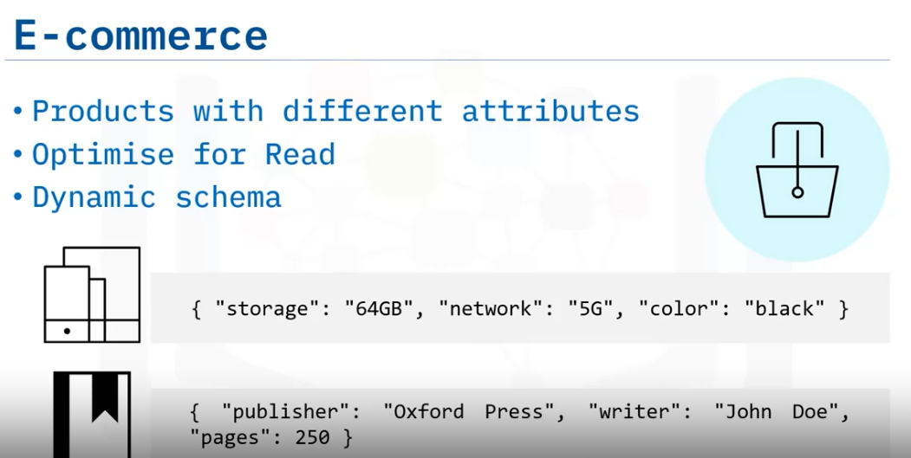
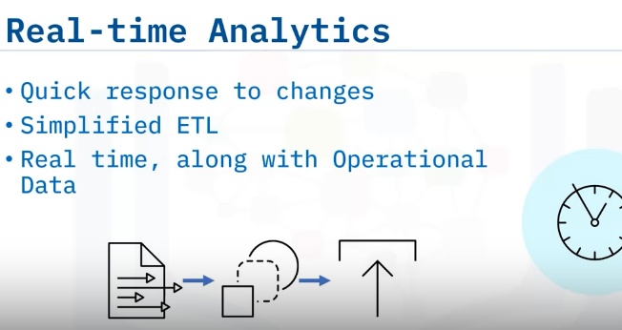
MongoDB can also be used with e-commerce solutions.
Products sold on an e-commerce website have different attributes.
For example, a phone has attributes such as storage, network, and color.
A book will have attributes such as publisher, writer, and number of pages.
Products also have attributes such as top reviews, pricing, inventory, and other metadata.
With the help of documents, sub-documents, and list properties in MongoDB, you can store the information together so it is optimized for reads.
This makes MongoDB a perfect fit for use cases allowing dynamic schema.
MongoDB is a good fit when you want real-time analytics.
Most organizations want to make better decisions based on their data.
Doing historical analysis is easy, but only a few can respond to changes happening minute by minute.
And most of the time, this is due to complex Extract, Transform, and Load (or ETL) processes.
With MongoDB, you can do most of the analysis where the data is stored.
That data can be semi-structured or completely unstructured.
All of this can be done in real time.

Slide 16
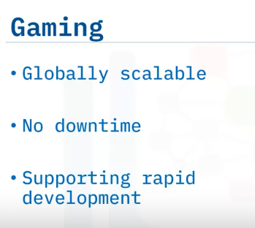
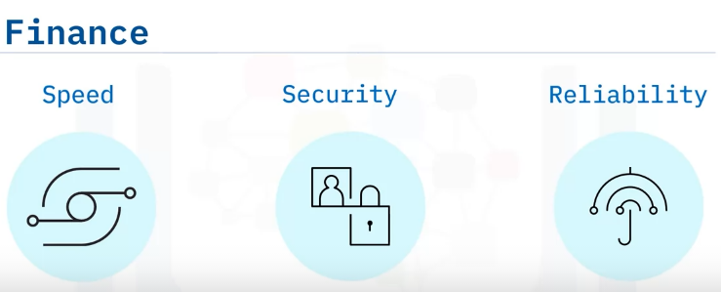
MongoDB has a part to play in the gaming world, too.
With more than ever multiplayer games being played globally, getting the data across is hugely important. With native scalability, also known as Sharding, MongoDB makes it easier to reach users around the world.
And again, with the flexible schema it is easier to support ever-changing data needs.
MongoDB has usage scenarios in the finance industry too.
Nowadays, we want our banking transactions to be as quick as possible, while we also expect the financial industry to keep our information secure.
With MongoDB, you can perform thousands of operations on your database per second.
And all the information is encrypted while in transfer and when stored on disk.
You can additionally encrypt individual fields to avoid any data incidents.
And finally, like every industry, financial institutions have much higher requirements for reliability and services being available around the clock.
We expect our finances to be available without any downtime. This makes MongoDB a good choice for banks, trading companies, and the financial industry in general.

Slide 17
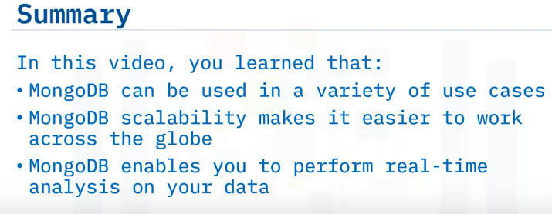
Summary and Highlights
Congratulations! You have completed this lesson. At this point in the course, you know:
MongoDB is a document and NoSQL database.
It is easy to access by indexing.
It supports various data types, including dates and numbers.
The database schema can be flexible when working with MongoDB.
You can change the database schema as needed without involving complex data definition language statements.
Complex data analysis can be done on the server using Aggregation Pipelines.
The scalability MongoDB provides makes it easier to work across the globe.
MongoDB enables you to perform real-time analysis on your data.

Slide 18
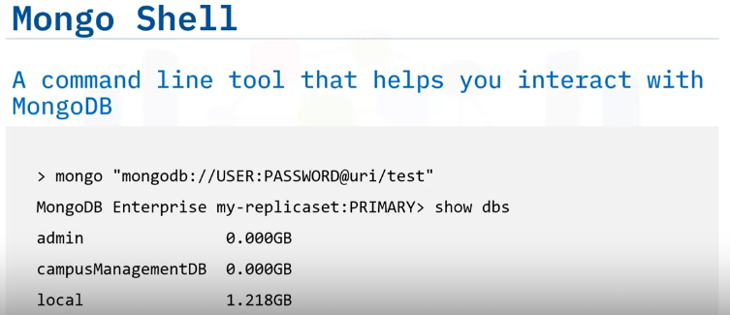
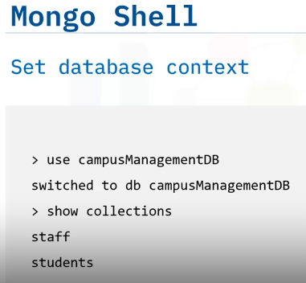
CRUD Operations
Mongo shell is a command line tool provided by MongoDB to interact with your databases.
It is an interactive JavaScript interface, and you can use it to perform data and administrative operations on MongoDB.
So, first we connect to our cluster by providing a connection string, And once connected, we can view the list of all our databases.
For simplicity, we will assume the shell is already connected to our MongoDB instance.
To start working on the campus management database, we run the following statement:
And then we can see what collections are present in the campus management database using this command:
It shows two collections: Staff and Students.

Slide 19
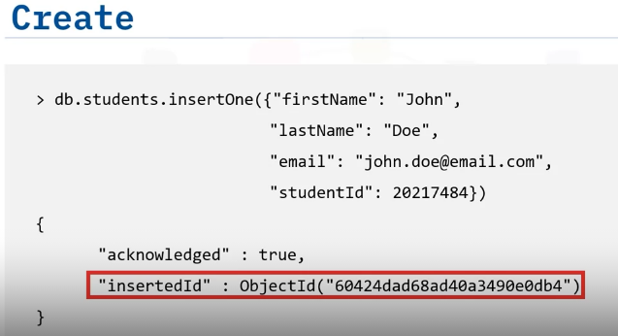
CRUD operations are Create, Read, Update, and Delete operations, hence the acronym CRUD.
Let’s start with a Create operation. We will insert a new document into the Students collection.
It takes the form of ‘db.’, which is the campusManagementDB database.
Then the collection name, which is ‘students.’
And then the ‘insertOne’ function, Which takes an argument as the document we want to create in the ‘Students’ collection.
The outcome is an acknowledgment that the operation was successful.
And since this was an insert operation, it shows ‘insertedId’.
‘_id’ <pronounced as “underscore id”>is a required field on every document in MongoDB.
Because we didn’t provide one ourselves in John Doe’s document, the Mongo shell driver will add the ‘_id’ field and generate the ‘ObjectId’ for us.

Slide 20
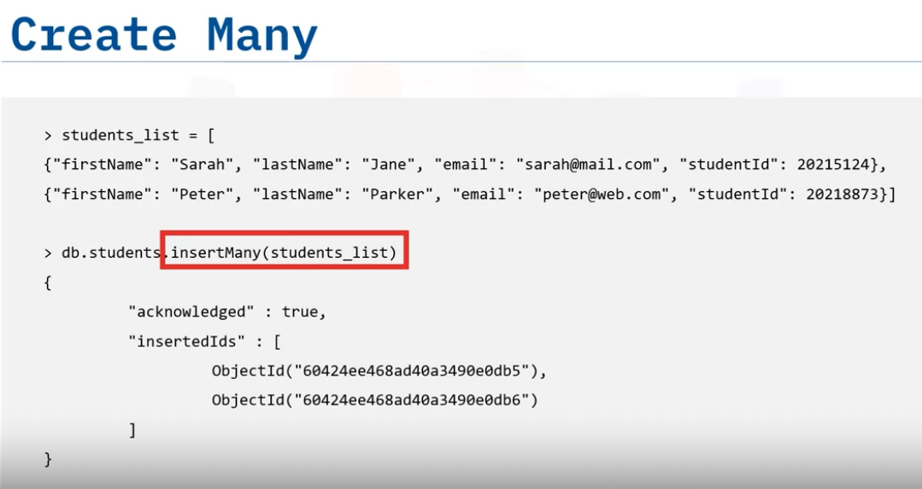
Mongo shell is a javascript interpreter, meaning you can define variables and perform other functions in it too.
Here, ‘students_list’ is created with two documents in it, and we can pass this as an argument to the ‘insertMany’ function.

Slide 21
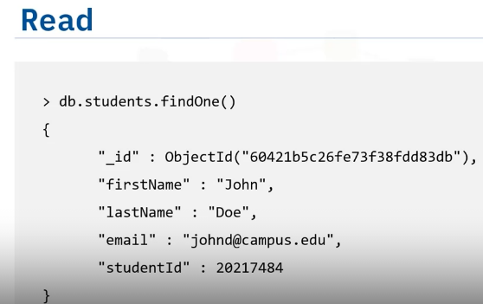
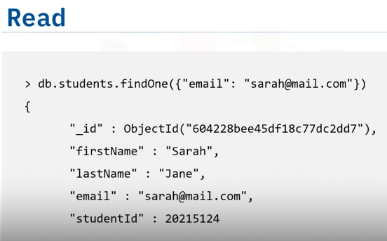
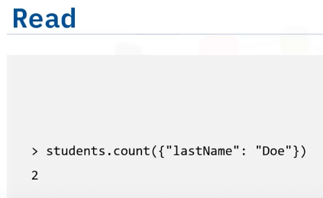
Now let’s do some Read operations. In the first one, we call the ‘findOne’ function, without any filter criteria.
This will return the first document in natural order, which is the order in which the database refers to documents on disk.
In this second Read operation, we want to find the first student with a specific email address.
If more than one document matches the criteria, only the first one will be read, as we are using the ‘findOne’ function.
Next, we want to retrieve all students with the lastname of ‘Doe’.
And finally, if we just want to count how many students have the lastname ‘Doe’, we call the ‘count’ function.
This count will happen on MongoDB, and only the number value will be returned

Slide 22
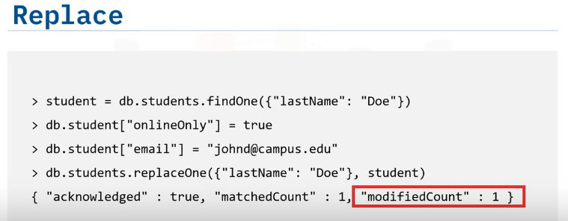
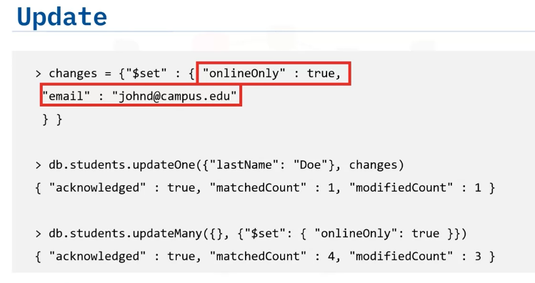
Let’s retrieve a student record and make some changes to the document.
We are creating a new field to identify which students are on campus or online only.
We will also update the email with campus’ email.
Once all changes are made, we will call the ‘replaceOne’ function, Which takes as its first argument, the filter criteria to find a document with last name of Doe.
The second argument is the updated student object.
The outcomes of this statement are: An acknowledgement The information about how many documents matched our filter criteria, and The count of how many were actually modified.
In the Replace example, we were sending the whole document back with the new changes.
For larger documents, this will take a lot of transfer time between the client and the database.
Instead, we can use MongoDB’s in-place updates for small changes.
So, we do this by constructing a ‘changes’ document, which in our case only has two assignments, which come under ‘$set’. Then we call the ‘updateOne’ function.
To update all of the students to online only due to lockdown, we can run the ‘updateMany’ function without any filter criteria, and a change document.

Slide 23
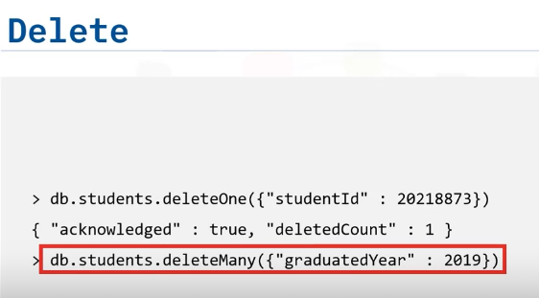
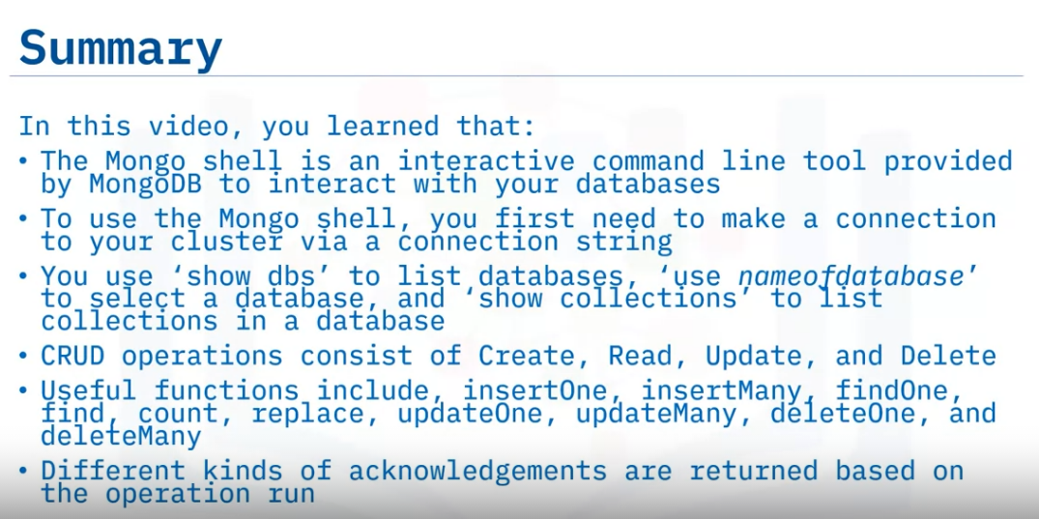
To run a delete operation, like update and find, the ‘deleteOne’ function takes filter criteria as a first argument.
Running that delete statement provides you with an acknowledgment and a number representing how many documents were deleted.
Similarly, you have a deleteMany function to delete more than one document meeting the criteria

Slide 24
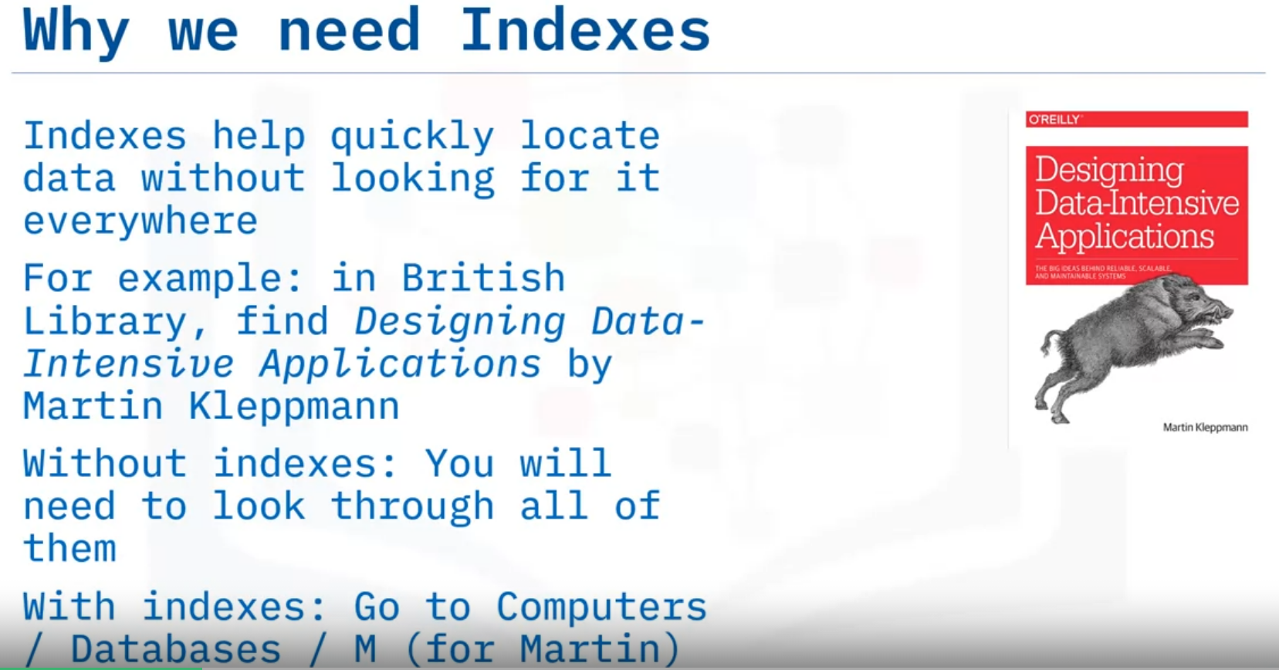
Indexes
Explain why we need indexes
Use indexes to perform efficient searches and sorts
Describe how MongoDB stores indexes.
Indexes help quickly locate data without looking for it everywhere.
For example, the British Library holds 25 million books. You are looking for ‘Designing Data-Intensive Applications’ by Martin Kleppmann.
Without indexes, you will need to look through all of them. With indexes, you go into the Computers section, then into the Databases aisle, and finally on the M shelf. There you will find the book by Martin Kleppmann.

Slide 25
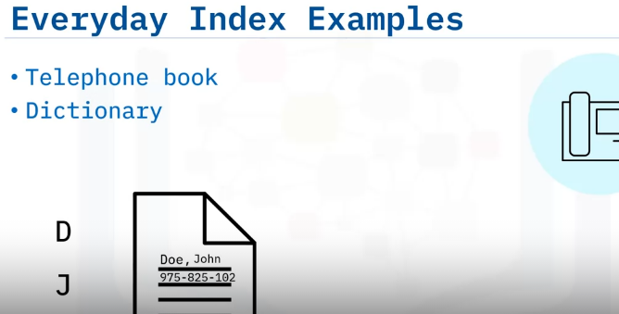
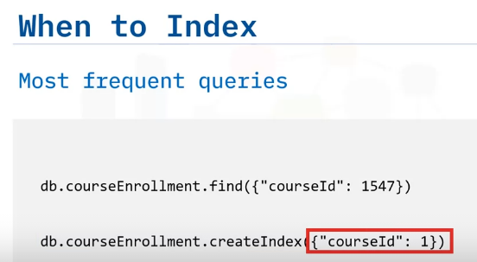
We use indexes every day to find information quickly. For example:
Until just a few years ago, telephone books were really popular.
All the names were indexed by surname and first name.
So, to find one person, you jump into their surname section.
D for Doe, then you go to first names starting with J , and you can easily find John Doe.
Other everyday examples include a dictionary and an index at the end of book.
In database systems, indexes should be created for the most frequent queries.
In the Campus Management Database, for the course enrollment collection, we find students using ‘courseId’.
Instead of scanning the whole collection, we create an index on the field ‘courseId’ in the course enrollment collection.
‘courseId : 1’ means store the index in ascending order.

Slide 26
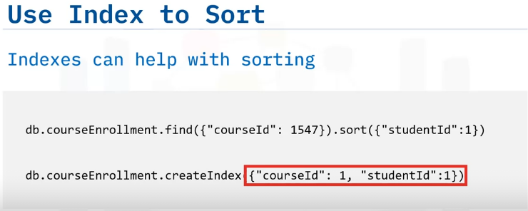
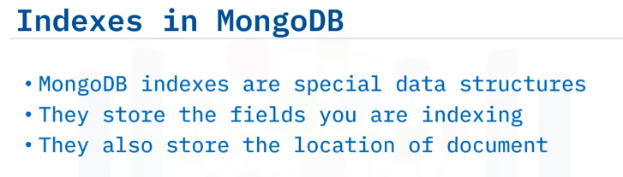
Our index on ‘courseId’ will help find those documents more efficiently.
But to organize the students by ‘studentId’ in ascending order, MongoDB will need to perform in-memory sort, which will not be efficient.
In this situation, we can change our index to be a compound index, which means indexing more than one field [here, courseID & StudentID].
Because the items in the index are organized in ascending order, once we find all documents with a’ matching ‘courseId’ of ‘1547, they will all be already sorted by ‘studentId’ because of this index.
Indexes in MongoDB are special data structures.
They store the fields you are indexing, and a location where that document is stored on disk.

Slide 27
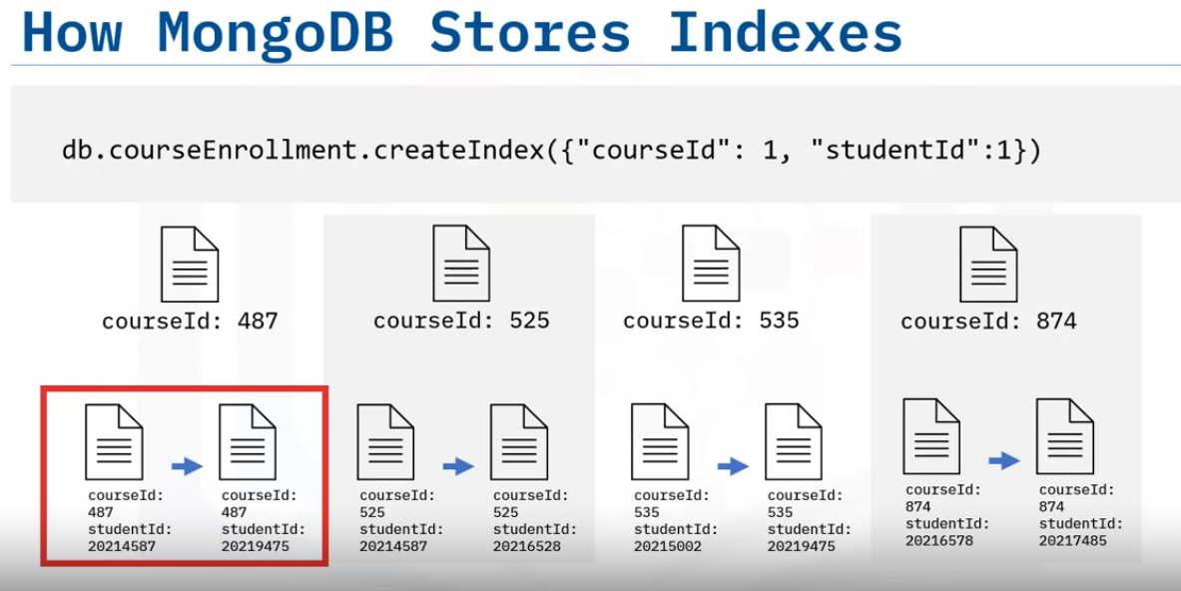
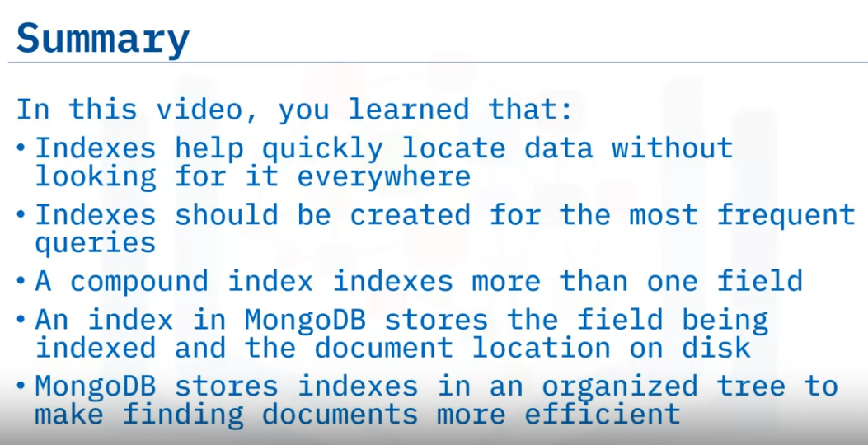
MongoDB stores indexes in a tree form: a balanced tree to be precise.
Imagine our last example: ‘courseId,’ being the first field in our compound index, is in ascending order.
Under each tree node, you will have students in ascending order too.
This makes finding documents much more efficient, whether it’s an equality or a range search.
And if you are sorting on a field which is already indexed, MongoDB doesn’t need to sort it again.

Slide 28
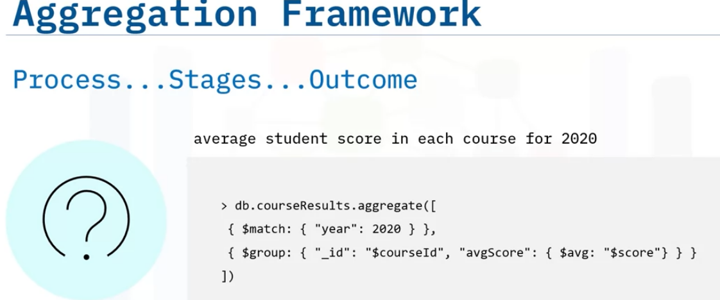
Aggregation Framework
Explain what Aggregation Framework is in MongoDB
Describe how is it built and what the most common stages are
And describe where you can use Aggregation
Aggregation Framework, which is also sometimes referred to as Aggregation Pipeline, is a series of operations that you apply on your data to get a desired outcome.
For example, to understand whether students are really developing their knowledge, you want to see the average student scores in 2020 by course.
This will mean filtering 2020 documents, then grouping those documents by course, then calculating an average score per year.

Slide 29
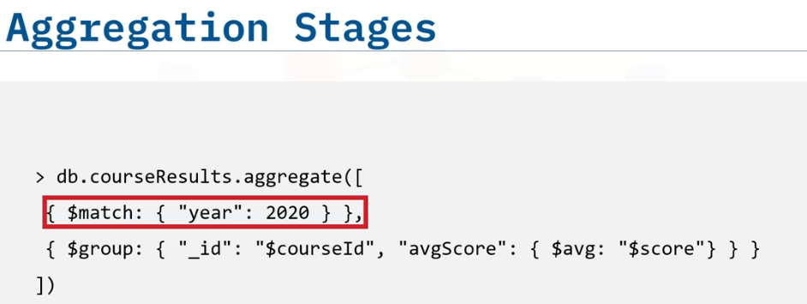
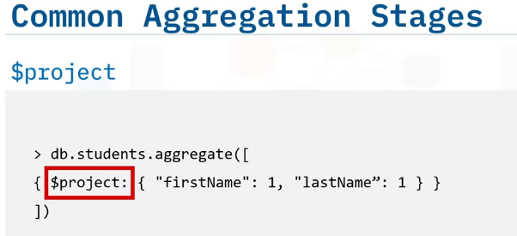
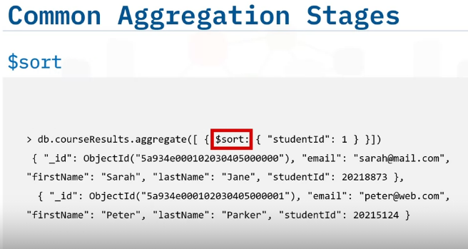
In our example, we have used these stages: ‘$match’, to filter out documents from year 2020 and ‘$group’, to group documents from the last stage using ‘courseId’, and calculating the average in a field called ‘avgScore’.
It is like a pipeline. Documents enter from one side, go through one or more processes, and come out in the desired format at the other end.
An aggregation stage can be repeated in a pipeline.
And the most common stages are: ‘$project’, if you want to change the shape of documents or project out certain fields, ‘$sort’, to sort your documents,

Slide 30
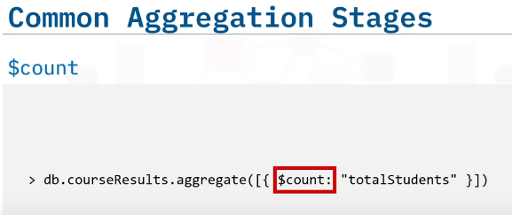
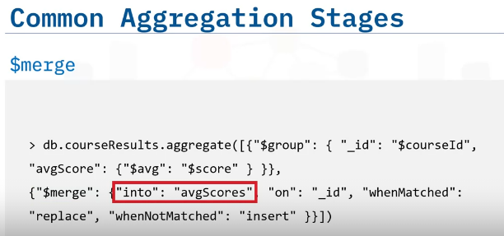

‘$count’, to count and assign the outcome to a field called total students, and ‘$merge’ takes the outcome from the previous stage and stores it into a target collection.
Now that we understand what different stages are in the MongoDB aggregation pipeline, let’s talk about where you will use it.
Like we saw earlier, it can be used to track the progress of students by course.
Another example could be, in an ecommerce application, the average sale of a product per country.
These kinds of reports can easily be created through the aggregation pipeline.
These can be complex calculations or simple grouping of data to provide a different picture of the data.

Slide 31


Slide 32

Replication & Sharding
Describe what replication is
Explain how it helps with high availability
explain how sharding helps to scale a database
A typical MongoDB cluster is made of three data bearing nodes.
All three nodes have the same data, hence the name ‘replica set’.
Data is written to the Primary node. Which then gets replicated to the Secondary nodes.

Slide 33

Having multiple copies of the data by the means of replication creates redundancy, so that if one piece of server hardware fails, you still have multiple copies of the data present.
This provides you with a highly available database during such failures or during periods of planned maintenance.
Such planned maintenance should be done in a rolling fashion, taking one node out for operating system, security, hardware, or software updates, or for upgrading MongoDB itself.
A common misconception about replication is that it can save you from disasters, such as accidently deleting your database.
Since it is a replica set, what happens on the Primary will be replicated over to the Secondaries.
For disaster recovery scenarios, we rely on backups and restores.

Slide 34


After using MongoDB for some time, you will probably outgrow your hardware.
For example, you need to store even more data, or you want to improve on your read and write performance.
Naturally, you will invest in bigger and faster hardware to increase capacity, But sometimes that is not feasible.
In those situations, you can scale horizontally by implementing Sharding, Which is the partitioning of your biggest collections.
Sharding your biggest or most demanding collections has many benefits.
When you partition your data across shards, you increase your throughput by directing your queries only to relevant shards.
You are also then able to store more data, which previously you couldn’t fit on a single node.
You can also split data across shards based on regions So, data for US customers will only live on shards running in the US, while European customers have their data on European-based shards.
As a global application, you get one view of your database to manage.

Slide 35


Slide 36

Accessing MongoDB from Python
Explain what the MongoClient is
Perform basic CRUD operations for our Campus Management database using Python.
The MongoClient is a class that helps you interact with MongoDB.
First, we import MongoClient from pymongo, which is an official MongoDB driver for Python.
The ‘uri’ tells us the address where MongoDB is.
Then we create MongoClient, which we should only do once in our code.
The next part gets the object pointing to the campus management database, And finally, from the campus management database object, we point to the ‘students’ collection.

Slide 37


Now that we have a reference to the ‘students’ collection, Let’s create a student document.
For this, we call the ‘insert_one’ function, which takes the document we are trying to insert as its input.
We can also do a bulk insert by calling the ‘insert_many’ function.
This function takes a list instead as its input.

Slide 38

Now let’s do some Read operations.
In the first one, we call ‘find_one’, without any filter criteria.
This will return the first document in natural order, which is the order in which the database refers to documents on disk.
Then we find the first student with an email.
If more than one document matches the criteria, only the first one will be read, because we are using the ‘find_one’ function.
To get all the documents, we do a ‘find’.
Now we are retrieving all students with the lastname of Doe.
And finally, if we just want to count how many students there are with the lastname Doe, we call the ‘count’ function.
This count will happen on MongoDB, and only the number value will be returned to the client.

Slide 39


When we do a ‘find’ on a collection in MongoDB, we get a cursor back.
This cursor points to our documents in MongoDB. If you have run this using mongo shell, the shell retrieves those documents for you behind the scenes.
To retrieve documents from our cursor, we call python ‘dumps’, which will exhaust our cursor to retrieve all the documents.
Let’s retrieve a student and make some changes to the document.
We are creating a new field to identify whether students are on campus or online only.
We will also update the email with the campus email address.
Once all changes are made, we will call the ‘replace’ function, Which takes its first argument as the filter criteria to find a document with last name of Doe, And the second argument is the updated python object
In the Replace example, we were sending the whole document back with the new changes.
For larger documents, this will take a lot of transfer time between the client and the database.

Slide 40


We can use MongoDB’s in-place updates for small changes.
We do this by constructing a change document, which in our case only has two assignments, which come under ‘$set’, And with this in-place update, we don’t even need to retrieve the student document.
To update all of the students to online only due to lockdown, we can run the ‘update_many’ function without any filter criteria, and change all documents.
Just like update and find, the ‘delete_one’ and ‘delete_many’ functions take filter criteria as the first argument, And these functions will delete one or many documents in the given collection matching the criteria

Slide 41


Slide 42
Summary and Highlights
Congratulations! You have completed this lesson. At this point in the course, you know:
CRUD operations consist of Create, Read, Update, and Delete.
The Mongo shell is an interactive command line tool provided by MongoDB to interact with your databases.
Indexes help quickly locate data without looking for it everywhere.
MongoDB stores data being indexed on the index entry and a location of the document on disk.
Using an aggregation framework, you can perform complex analysis on the data in MongoDB.
You can build your aggregation process in stages such as match, group, project, and sort.
Replication is the duplication of data and any changes made to the data.
Replication provides fault tolerance, redundancy, and high availability for your data.
For growing data sets, you can use sharding to scale horizontally.
MongoClient is a class that helps you interact with MongoDB.

